Slide 1
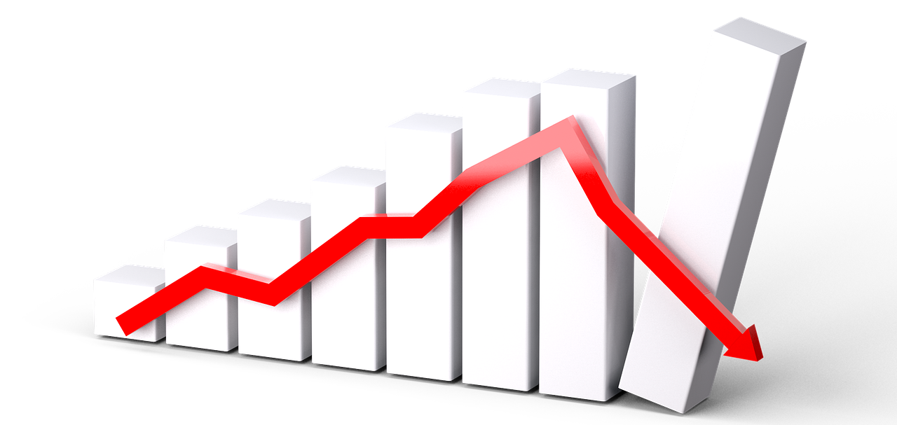
Stock Trading Bot with Reinforcement learning
Mohdi Habibi (010302851)
Rakesh Amireddy (013858871)
Thasleem Tajudeen (014544907)

Slide 2
Introduction
Stock trading plays very important role in the growth of industry and overall economy
It is very challenging to come up with optimal trading strategy in such a dynamic environment
RL makes sense for financial market because the data is all time series and the trading environment can be described as Markov Decision Process
Since we don't know about other agents and their actions, we have a partially observable MDP, where we consider ourselves as the only agent.
We focus on three different techniques namely DQN, DDQN and Actor-Critic and compare the results in terms of selling profit and end portfolio value

Slide 3
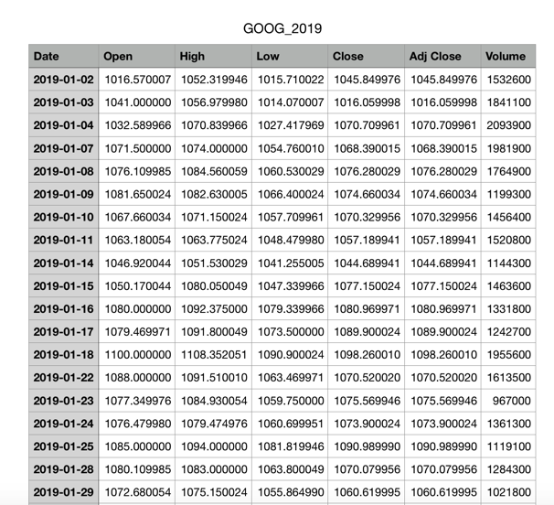
Data Set

Slide 4
Problem Formulation
State (Observation Space)
[nstock1, cash in hand, next opening price s1, portfolio value, past 5-day average]
Actions Rewards
Buy (0) +1 - If buying for less than previous buy
Sell (1) +1 - If selling for more than bought price
Hold (2) +1 - end of the series is reached
0 - for all other actions
Done
If end of the time series is reached Starting cash - 6000
Bankrupted Starting shares - 20
Sold more than have
Bot can buy or sell only one stock at a given timestamp

Slide 5
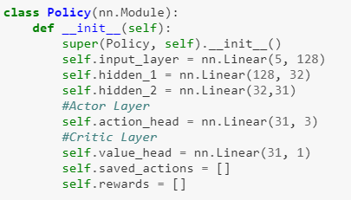
Actor - Critic
The Actor - Critic approach leverages the advantages of both policy based and value based RL approach
The actor network controls how our agent behaves. (Policy)
The critic network, on the other hand, reacts to what the actor-network does. (Value)
The learning is on - policy

Slide 6
Actor - critic Pseudocode
For 1..n episodes :
Until done :
Run the current state through the network
That outputs:
a set of "probabilities" for each action
a value for how good the state is
Sample from those probabilities to pick an action
That will return next_state, action, reward
Adjust each saved reward by the value of the terminal state
discounted by gamma each timestep
Loss = -(The log probability of the action * advantage)+ The value of that action compared to expected
Propagate the loss back and adjust network parameters

Slide 7
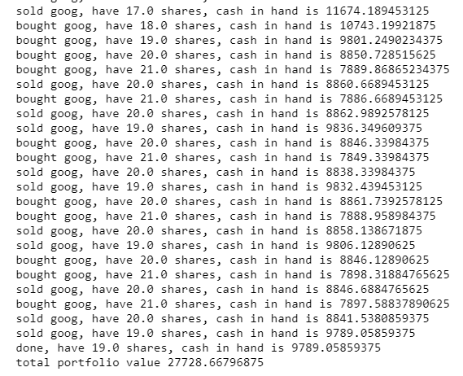
Sample run

Slide 8
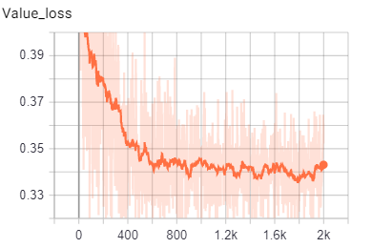
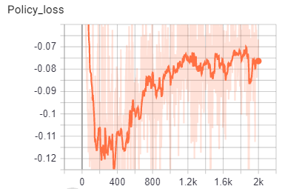
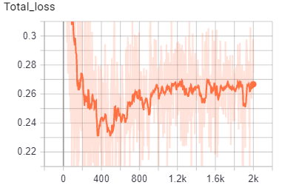
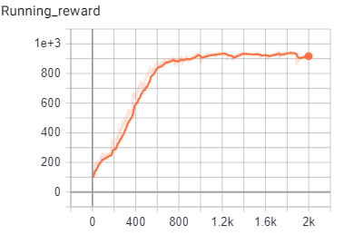
Training on Goog - 2010 - 2017 data

Slide 9
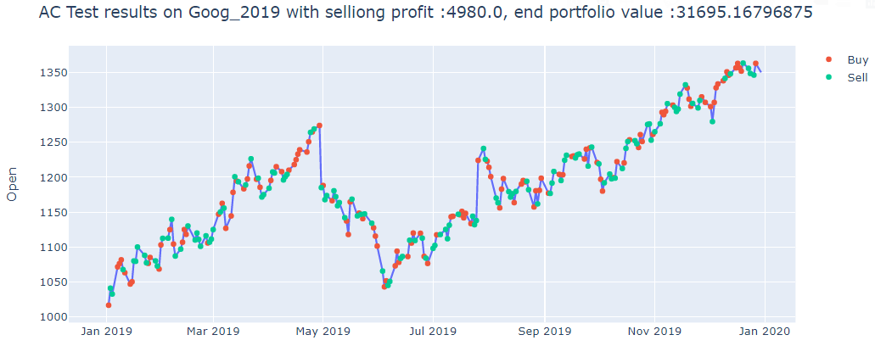
Tested results on Goog 2019 data
Starting Portfolio value : $26k , Have 17.0 shares and $8.7k cash. selling profit: $4.9k, Total portfolio value: $31k

Slide 10
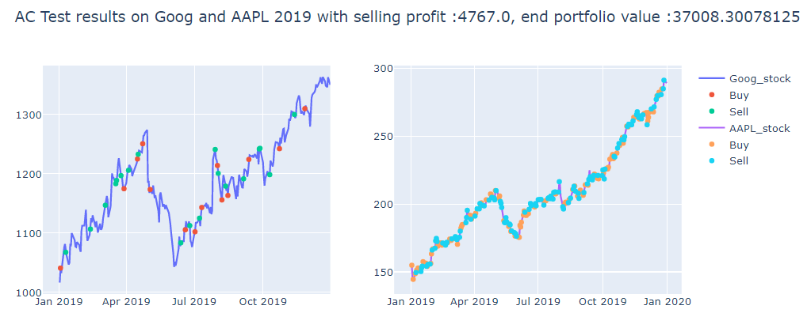
Tested results on Goog 2019 data and aapl 2019
Starting Portfolio value : $30k
Have 15.0 goog, Have 6.0 aapl and $14k cash. selling profit: $4.7k Total portfolio value: $37k

Slide 11
DQN Approach
Initialize replay memory capacity
Initialize the network with random weights
For each episode:
Initialize the starting state
For each time step:
Select an action Via exploration or exploitation
Execute selected action
Observe reward and next state
Store experience in replay memory
Train the agent using experience replay after specific batch size
Sample random batch from replay memory
Estimate Q-values based on current state and approximate target Q-values using deep q-learning equation
Calculate loss between output Q-values and target Q-values
Gradient descent updates weights in the policy network to minimize loss

Slide 12
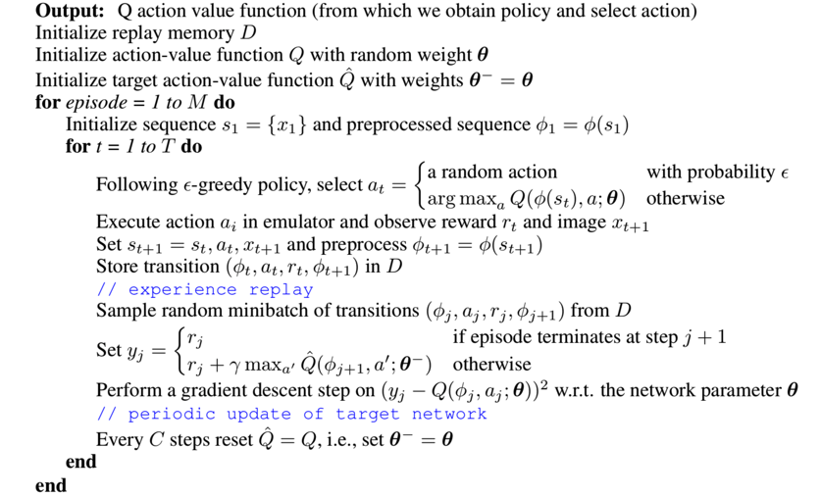
Deep Q-Network

Slide 13
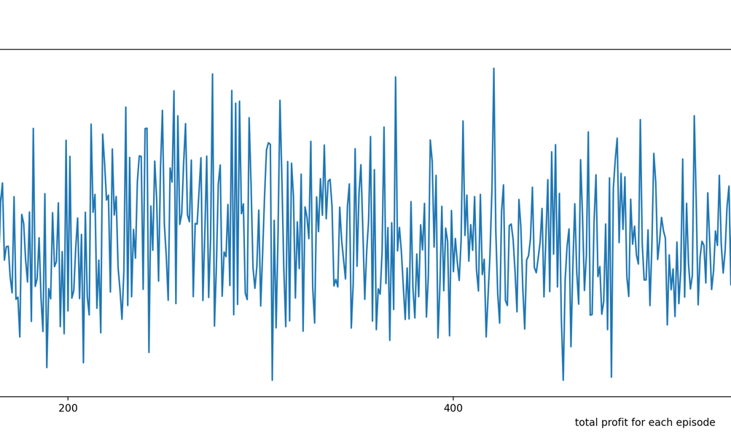
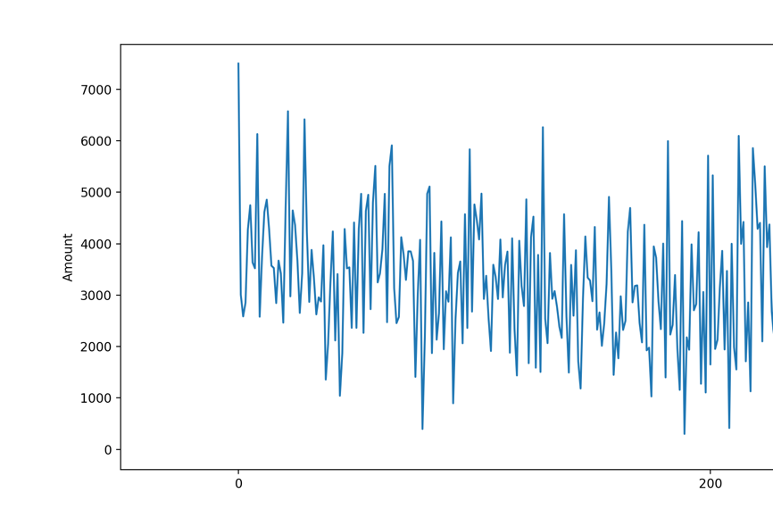
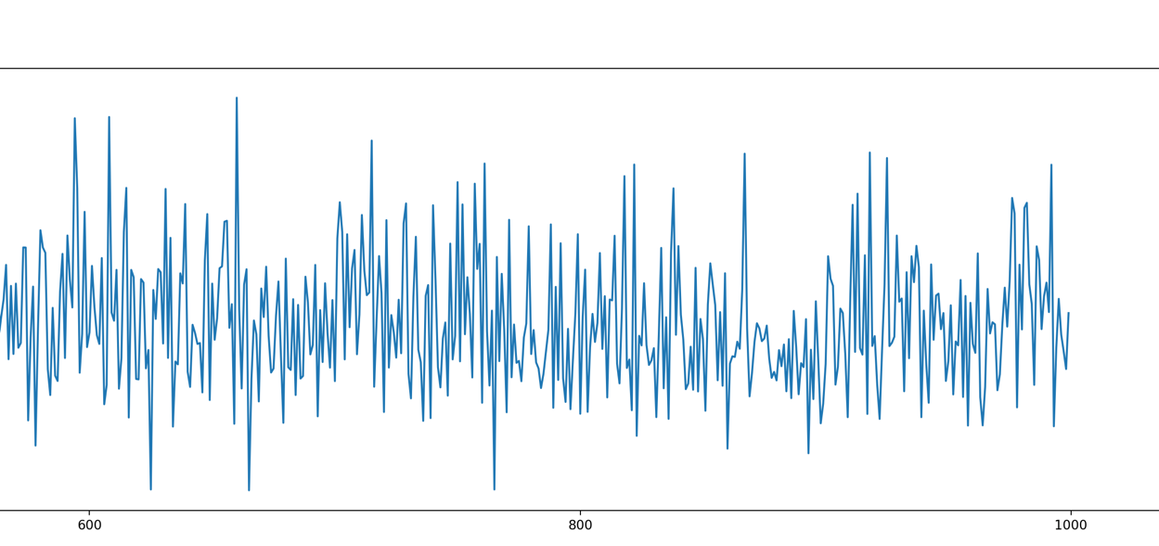
DQN Training Results

Slide 14
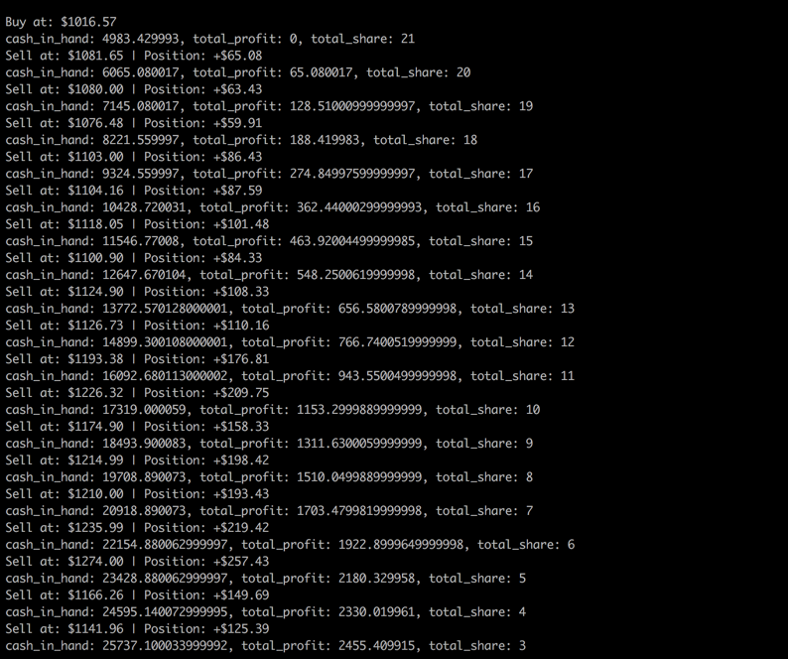
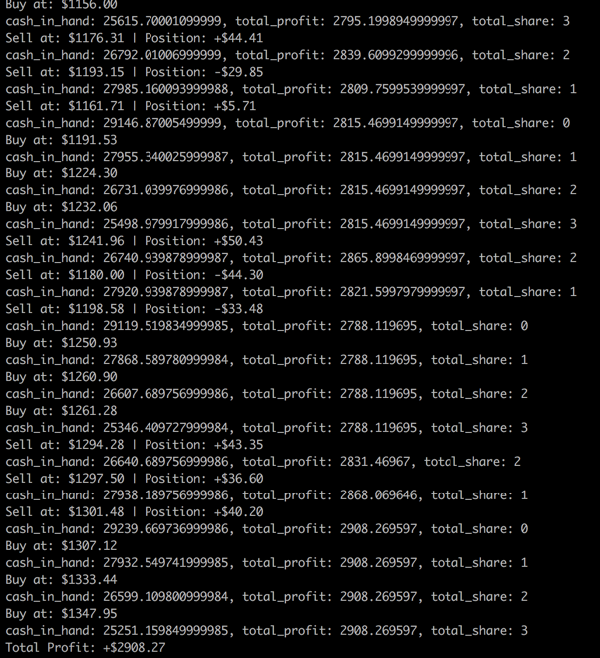
DQN Test Results

Slide 15
DDQN
DDQN is a multi-layered neural network that for a given state s outputs a vector of action values
Important parts are use of a target network, and the use of experience replay
Target network parameters the same as online network but updated every n steps
Observed transitions are stored for some time and sampled randomly in mini batches
Max in DQN can cause overestimation
Two value functions are learned by assigning each experience randomly to update one of the two value functions
One set of weights is used to determine the greedy policy and the other to determine its value

Slide 16
Our DDQN Setup
Same state space used across all implementations to have a fair comparison
Queue with 10000 max space for experience replay
Gama 0.95 affinity for long term reward
Start epsilon with value 1 and decay gradually
Agent starts with high randomness in acting in the initial episodes
Target model is updated to online model every 1000 iterations
2 NN in DDQN helps model to make better prediction
Online model predict the action value for a given state and the target model evaluate how

Slide 17
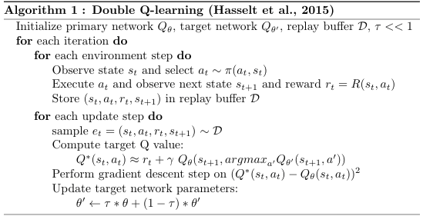
DDQN Pseudocode

Slide 18
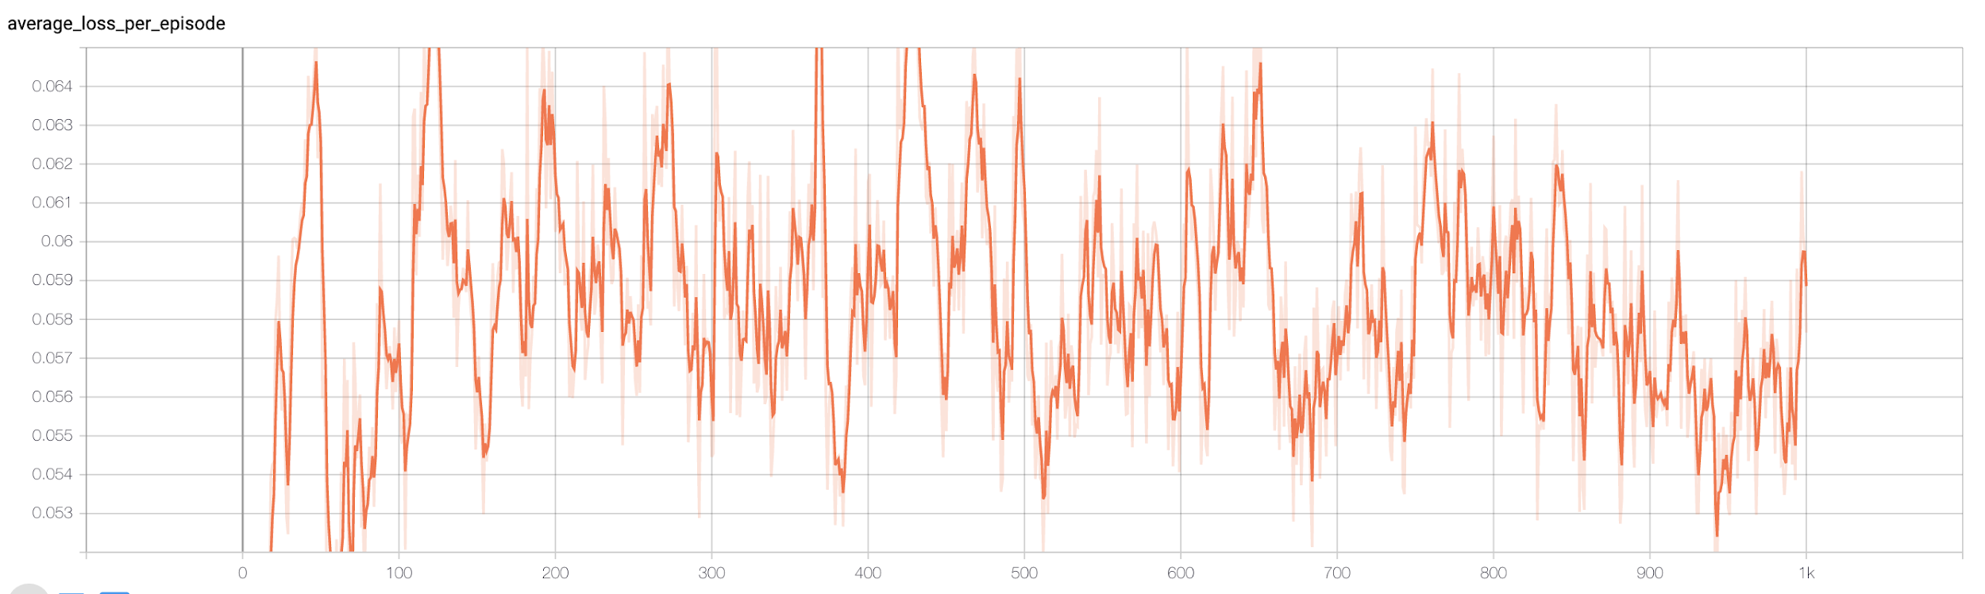
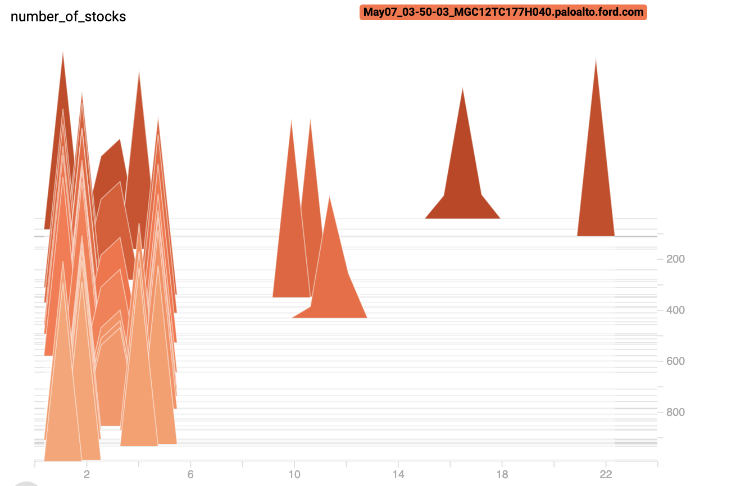
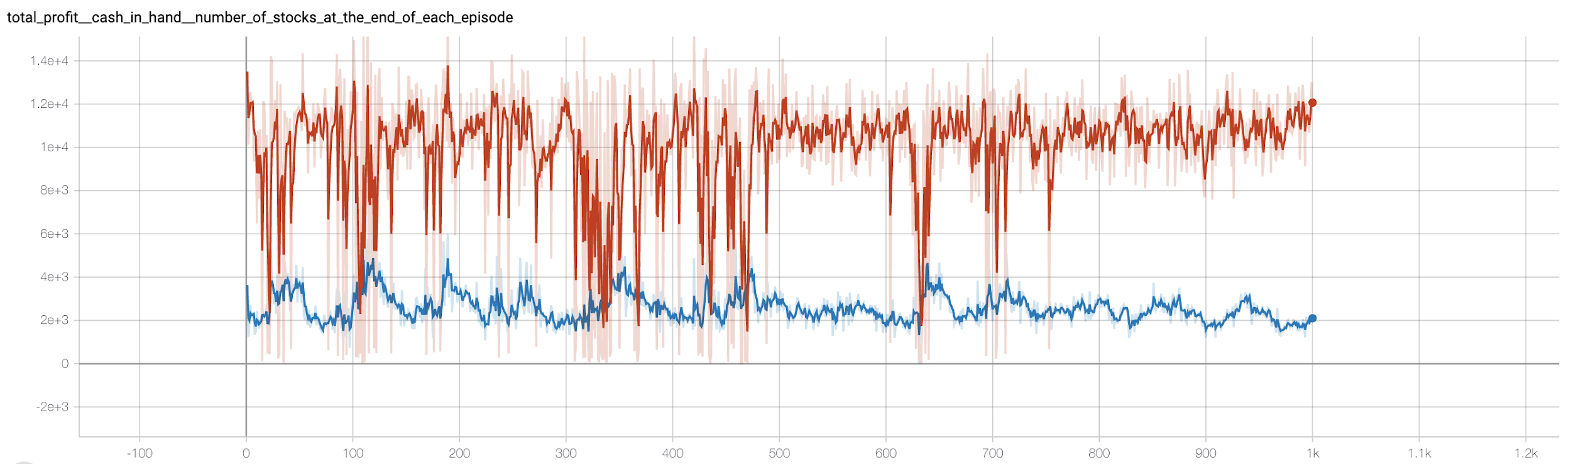
DDQN Training Results Single Stock (Google)

Slide 19
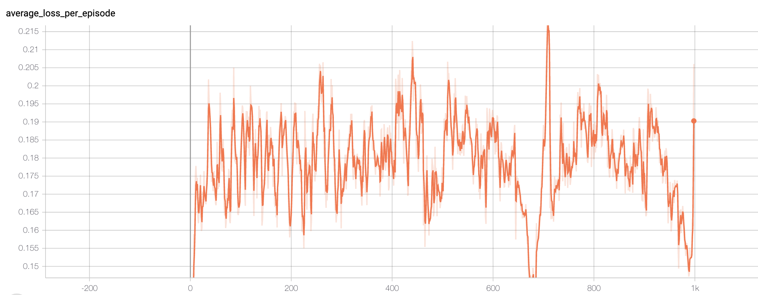
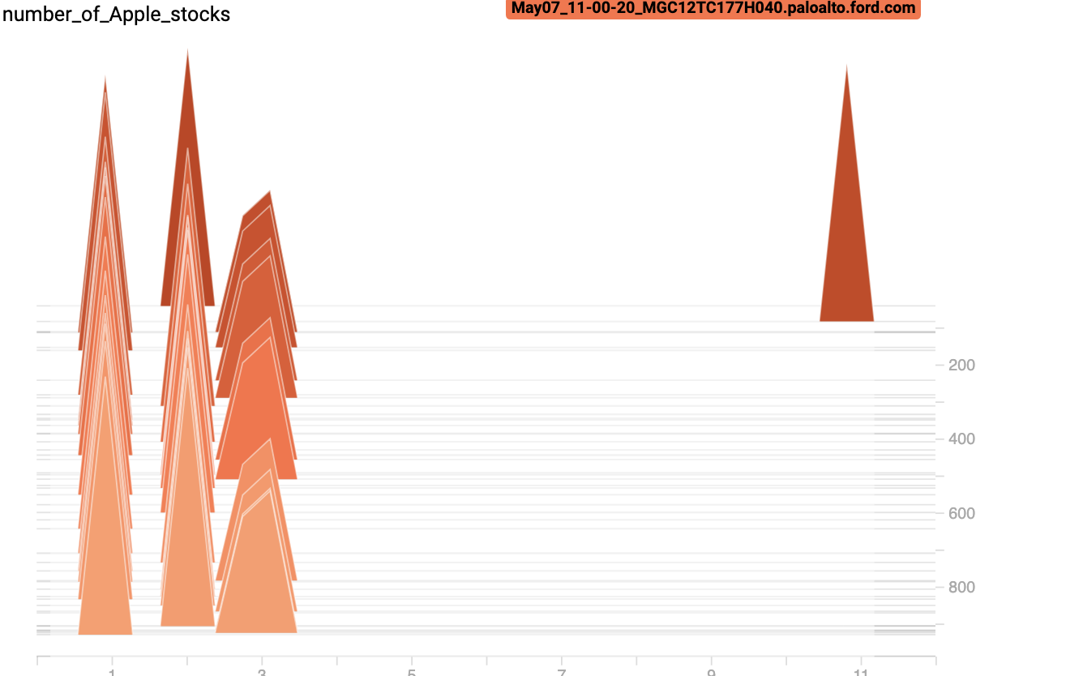
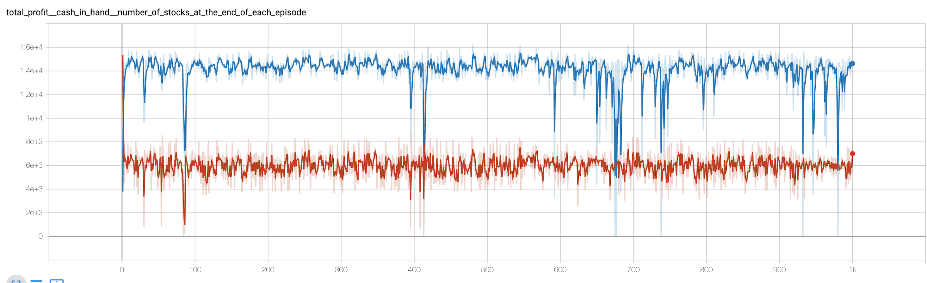
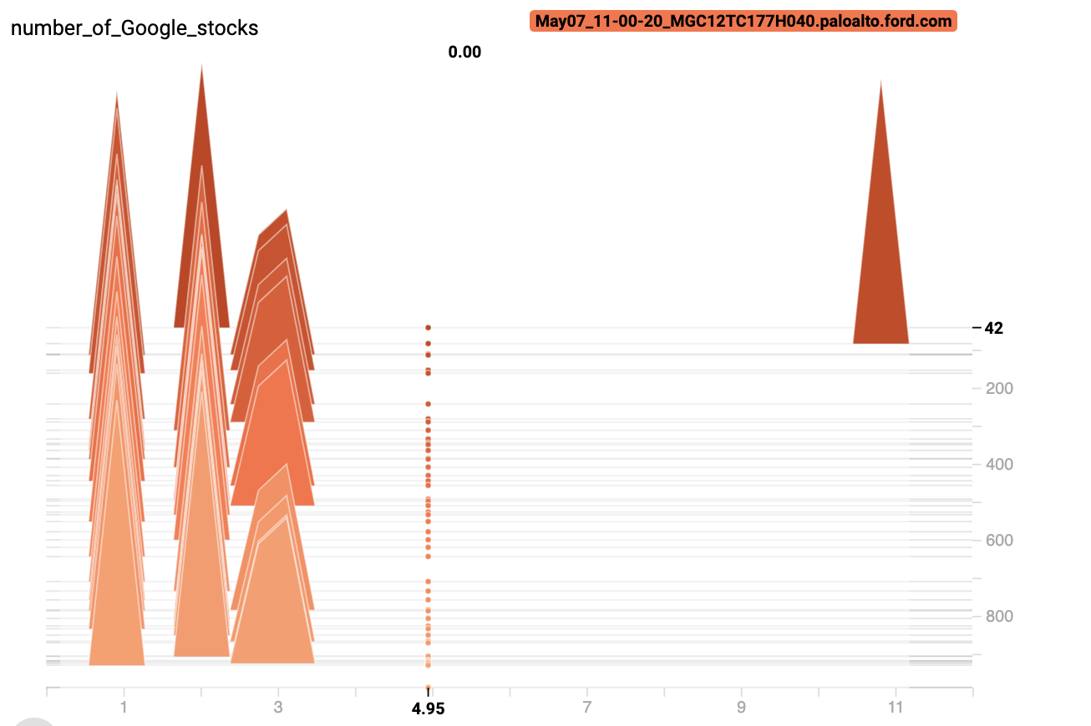
DDQN Training Results Double Stock (Google and Apple)

Slide 20
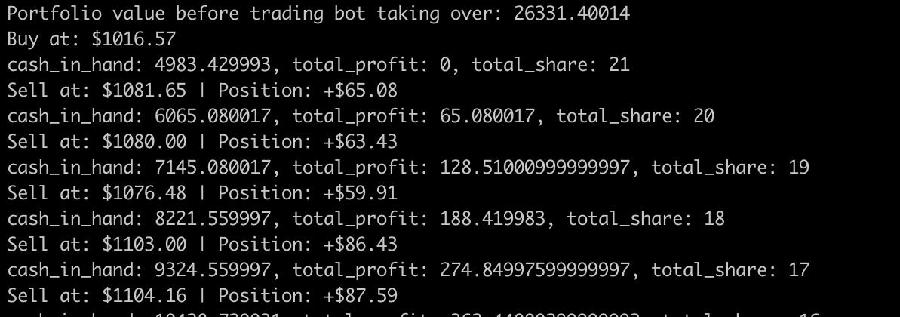
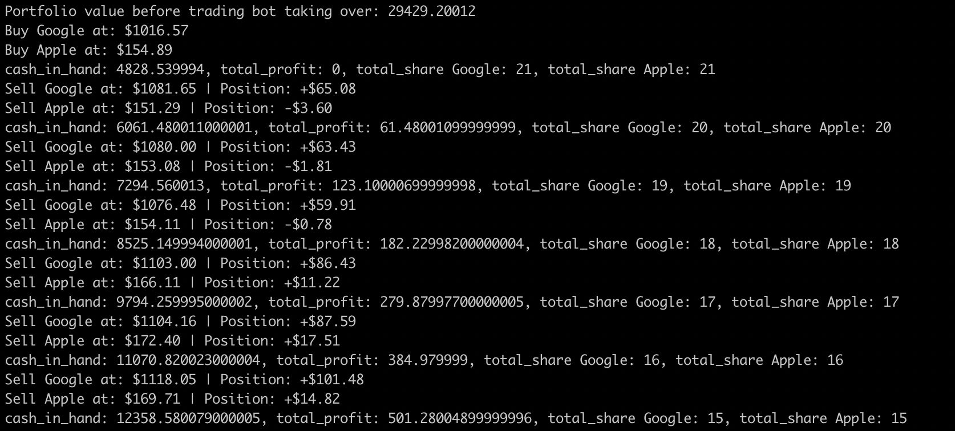
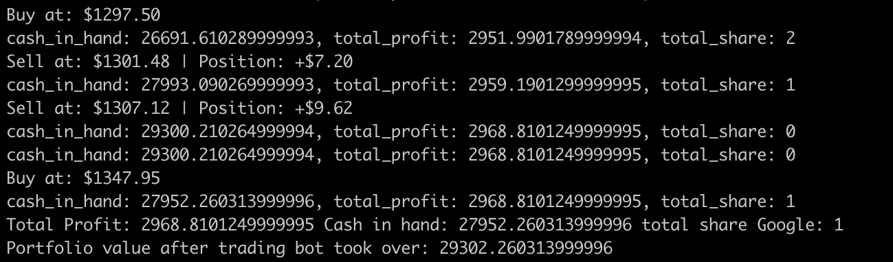
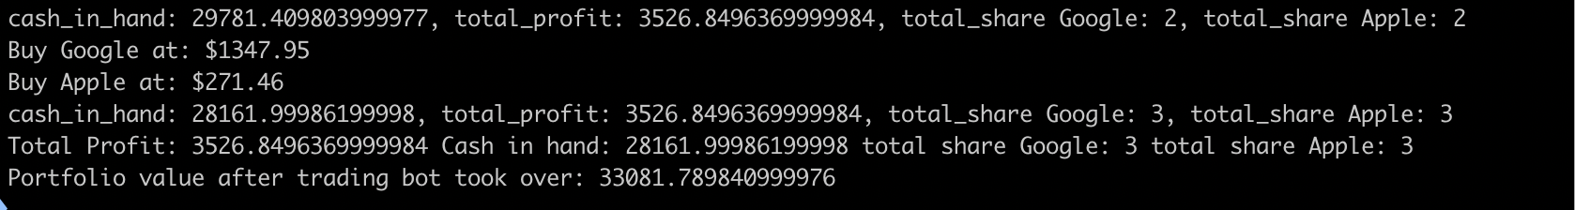
DDQN Results
<<<<
<<<<
Results for 1 stock portfolio:
$26K starting portfolio
$29K ending portfolio
Results for 2 stock portfolio:
$29K starting portfolio
$33K ending portfolio

Slide 21
Conclusion
Though the three implementations can’t be compared exactly in terms of the parameters, understood that DQN overestimates the Q-value as it always choose max q value for the future states
DDQN solves the overestimate problem by using another layer of neural network and predicts the best action to make better decision
Running two neural network at the same time takes significant amount of time at training step
It took longer to train with DQN and DDQN because of the replay buffer
It is clear that for this stock trading environment Actor - Critic is efficient - it learns on policy
The future enhancement would be to consider more factors such as other agents and finance news headings to predict stock trend

Slide 22
References
Van Hasselt, Hado & Guez, Arthur & Silver, David. (2015). Deep Reinforcement Learning with Double Q-learning.
An Actor-Critic Approach and why it might be useful to maximize your portfolio returns

Slide 23
Thank You!

